Slide 1

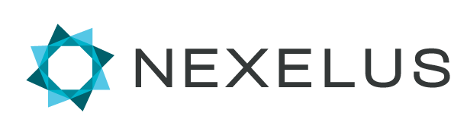
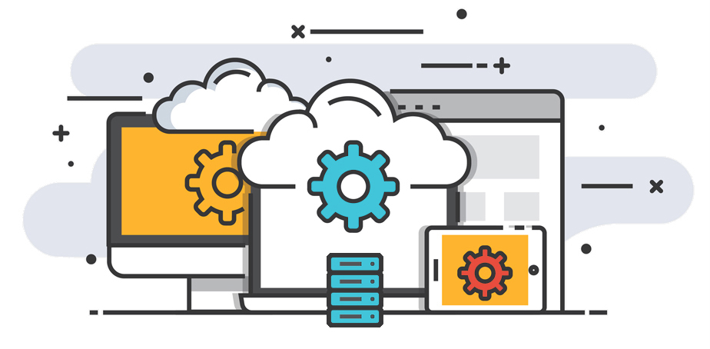
DCM, Google Ads, DV360, Meta, Microsoft Ads, Trade desk & Twitter.
Instructions for Set up of API Integrations with Nexelus for:

Slide 2
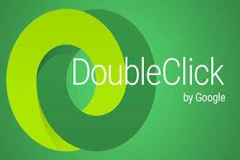
DCM Api Integration with Nexelus

Slide 3
DCM Sites
Our login Nexapi@nexelus.net has API read only access to the Test account/network. We need following access
Full Read access
Write access to create/edit Campaigns, placement/packages and Ads.
DCM: If the new client is using DCM, we need the ‘write’ access to DCM live accounts. See slides 4-8
Steps:
Add a Nexelus User Nexapi@nexelus.net to DCM with required access & permissions
Send Nexelus list of DCM Sites

Slide 4
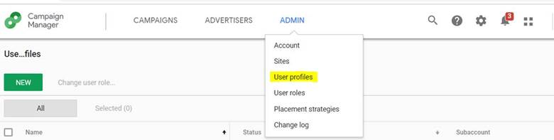

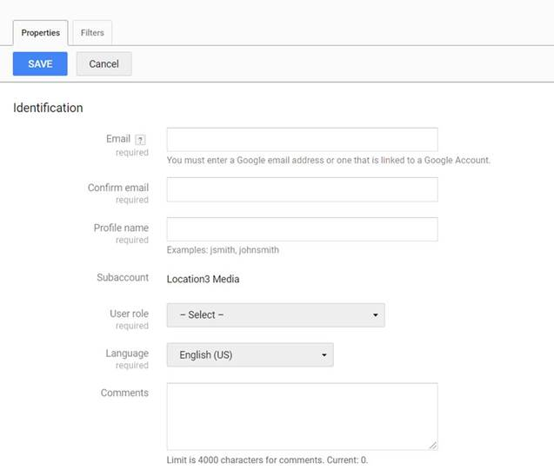
Add a Nexelus User to DCM
Click on “Admin” menu and select User profiles
Click on “New” button; this opens a window for new profile
Enter Information in newly opened window
Enter Nexapi@nexelus.net in email and confirm email field
Enter profile name. You can use any name, however it’s preferred to use “Nexelus_Account” where account is DCM account number
Select appropriate role
You can use the default role “Agency Media Planner”. Or create a new role; see next slide for Permissions needed.
Select “Filter” tab, where you can filter data which this profile can access, you can select “Allow all” for all categories if you want to give this profile access to all data under this account
Press “Save” button to save profile

Slide 5
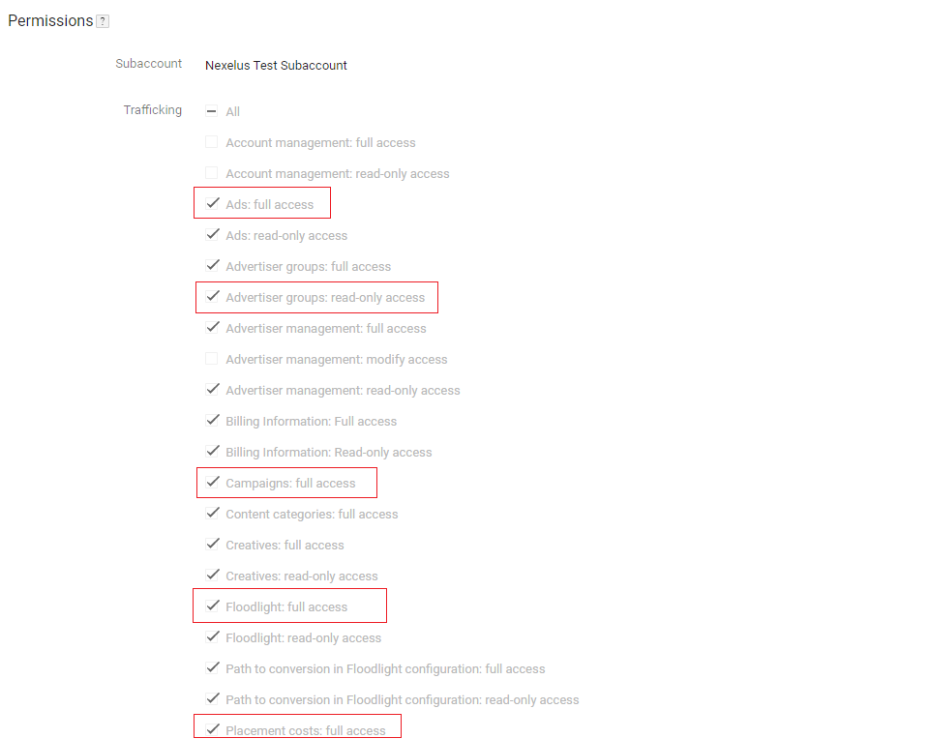
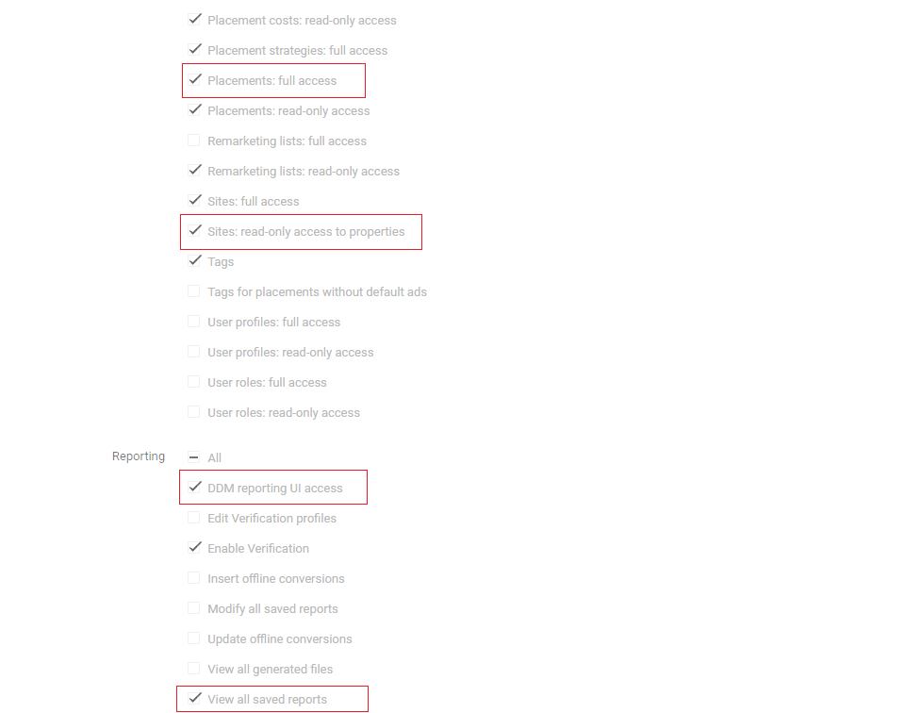
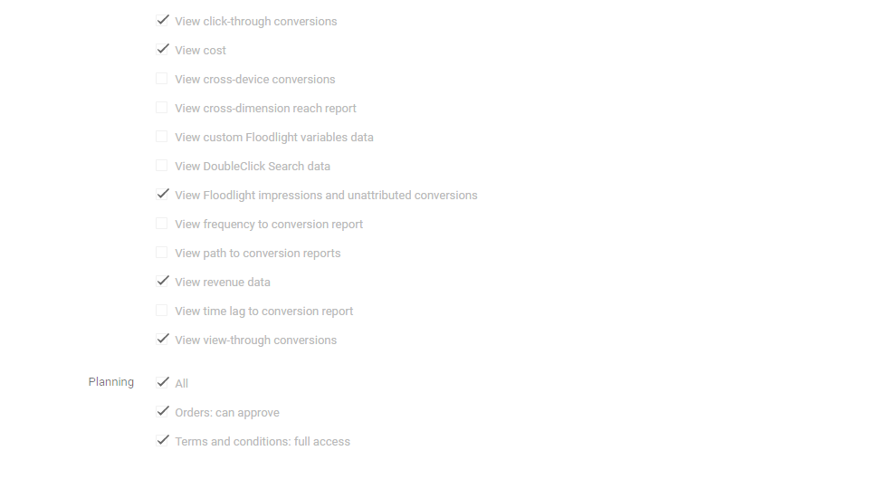
Needed Permissions
If choosing to create a new User Role for Nexelus, please ensure they are provided the permissions indicated in the screenshots by red boxes

Slide 6
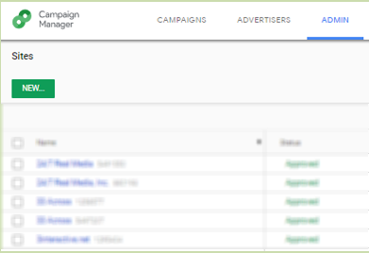
DCM Sites
Please provide Nexelus with a list of DCM Sites (and their IDs) from the Network which company may be expect to use in the future.
We will set these up in Nexelus.

Slide 7

Meta (facebook) Api Integration with Nexelus

Slide 8
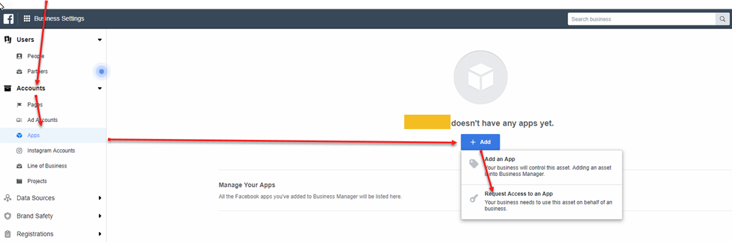
Meta
Add Facebook NEXELUS App:
To add the Nexelus App in Facebook. The Facebook Admin needs to follow the below steps:
In the Business Settings, click on Accounts >> Apps then click on Add button, in the drop-down menu click on “Request Access to an App”.

Slide 9
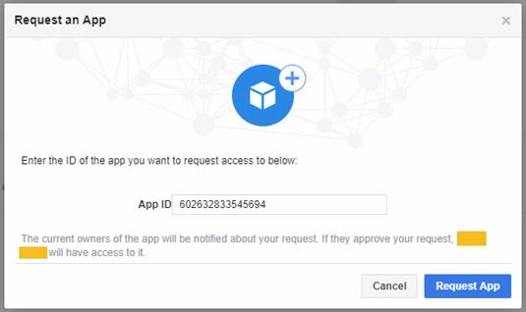
Meta
In the pop up fill out the field using Nexelus App ID 602632833545694. Once, Nexelus approve the request you should see the app appear on the Apps screen.

Slide 10
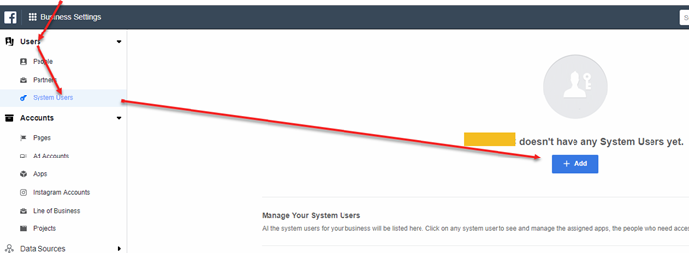
Meta
Once the permission is granted. You will need to create a system user.

Slide 11
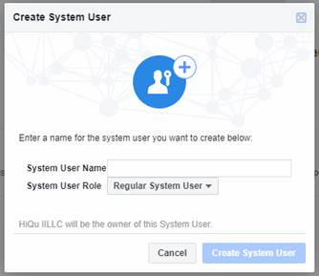
Meta
In the popup “Create System User”. Please name the user “Nexelus” and keep the system User Role to “Regular System User”.

Slide 12
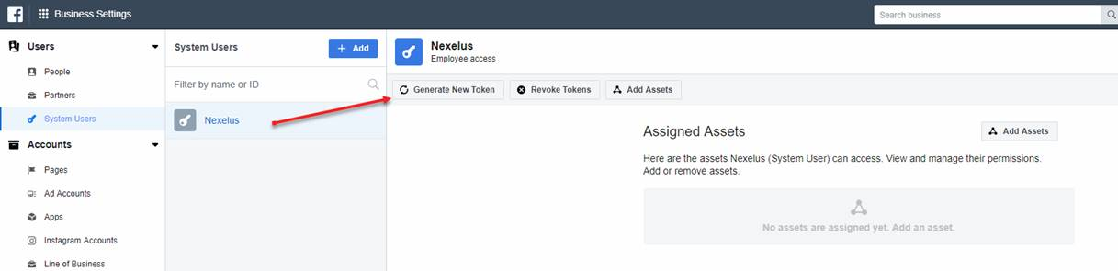
Meta
After the user is created. Please select the user and generate a token.

Slide 13
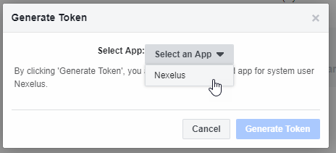
Meta
In the pop up, select the Nexelus app.

Slide 14
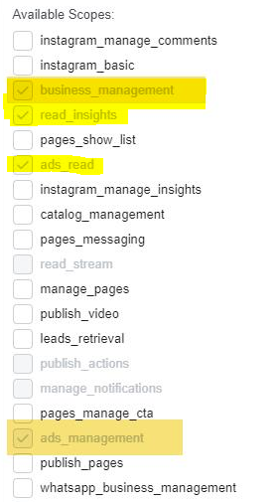

Meta
After the App is selected. Please check of the following settings and then click on “Generate Token”

Slide 15
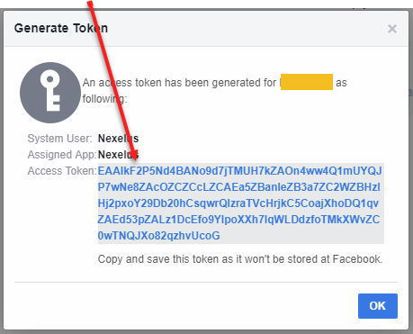
Meta
After the token is generated, please provide the “Access Token” to Nexelus.

Slide 16
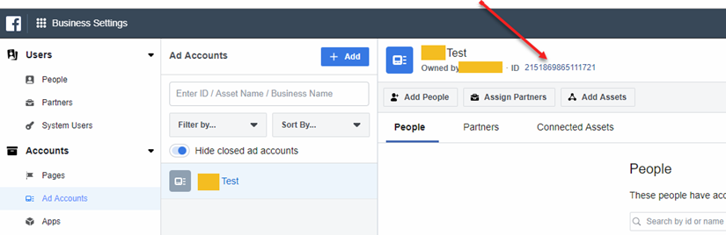
Meta
Please also provide your Ad Account ID that you would like Nexelus to pull delivery data from. This is located under Accounts >> Ad Accounts.

Slide 17
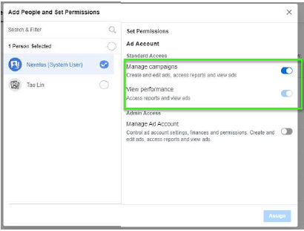
Meta
In the Ad Accounts, please add the System User “Nexelus” in the Ad Account and grant only view performance access.

Slide 18
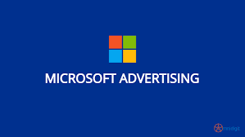
Microsoft Ads Api Integration with Nexelus

Slide 19
Microsoft Ads access
We need access to Microsoft Ads in order to pull delivery and create IOs.
We need access to your account
Please add Nexelus email address "Nexapi@nexelus.net"
Do you have a developer token for Microsoft Ads API?
If so please provide us.
If not please generate. Here is a link on how to do it. Let us know if our assistance is required.

Slide 20

Google Ads Api Integration with Nexelus

Slide 21
Google Ads
We have all access. However, please specify an account that we can use for testing.
Important note for Google Ads:
We need to firm-up on below two points:
Confirmation, if the new client is part of Main MCC or if it has a separate MCC of it’s own
Confirmation, if the new client is already whitelisted for API integration by Google. If not please ask your rep to whitelist.
Whitelisting a MCC
1- Get a developer token from Google Ads which will allow us to integrate. If you already have a developer token for a client’s MCC then simply provide us with Token and password.
To get a new developer token, please fill this form as detailed on sign-up page.
Check with your Google rep or Google API team if your MCC is whitelisted for Budget Order API (for budget order service API, i.e. ability to create Budget Order from Nexelus)
Note that the 360i Master MCC is already whitelisted for Budget Order creation.
Use attached Design document when signing up for developer token or whitelisting MCC.
2- Access level: We will need “Basic” access for the API.
3- Once we have the access please allow “Permissible” usage for ‘Ad creation / management’ and ‘Reporting’. Application link can be found here.

Slide 22

Twitter Api Integration with Nexelus

Slide 23
Twitter
Login to twitter developer account on https://developer.twitter.com
If you don't already have a Twitter Developer Account, you'll need to apply for one. Follow the instructions provided by Twitter to apply for access.
https://developer.twitter.com/en/portal/petition/essential/basic-info
If you already have developer account, please follow the instruction below.

Slide 24
Twitter
Creating a Project
To create a Project, click on “New Project” in your dashboard or the Projects & Apps page within the developer portal. You’ll only be able to see this option if you haven’t already created a Project. You will be prompted to create a Project name, description, and use case. You will also be asked to create a new App or connect an existing standalone App
Creating or Connecting an App for your Project
Accessing the Twitter Ads API endpoints requires a set of authentication credentials, also known as keys and tokens, that you must pass with each request.
Each Project can contain an App, with which you can generate authentication credentials (keys and tokens).
If your Project doesn’t include an App, you can add one by clicking on the Project name in the dashboard. From there, you can create a new App. The App is where you can generate your authentication keys and tokens, including the API Key and API Secret, Access Token and Access Token Secret. You can add a maximum of 10 apps to your project.

Slide 25
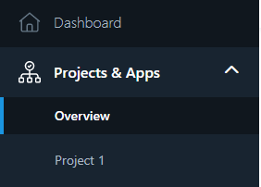
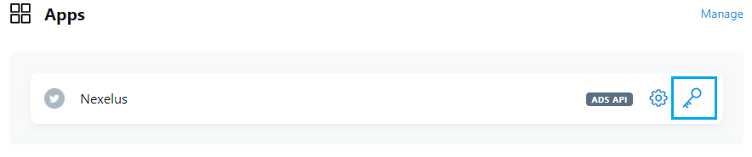
Twitter
From the left menu, under Projects & Apps, click on the project. It will display the Apps in that project.
Click on Keys and Token icon.

Slide 26
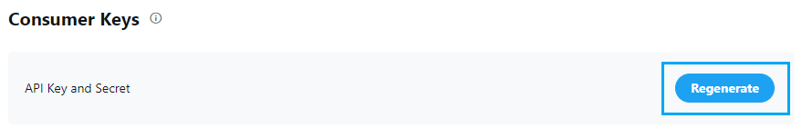
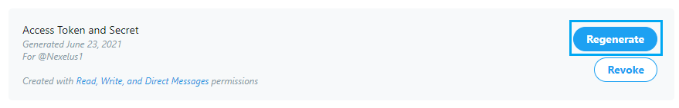
Twitter
Generate two Consumer keys as API Key and API Secret and save somewhere
Generate two Authentication tokens as Access Token and Access Secret and save somewhere
Provide the generated 4 keys to Nexelus consultant.
Consumer Key (API Key), Consumer Secret (API Secret), Access Token, and Access Token Secret
Please note that you cannot regenerate these Keys once provided to Nexelus as it will create new credentials and invalidate the old ones. This means that any integrations that have been setup with prior credentials have to be updated.

Slide 27
DV 360 Api Integration with Nexelus
Display & Video 360

Slide 28
Display & Video 360
Generate credentials
The following instructions guide you through the process of creating an OAuth 2.0 client ID to use with the installed application flow.

Slide 29
Display & Video 360
Follow the steps to configure a Google API Console project.
2.Open the Credentials page in the API Console
3.Click Create credentials > OAuth client ID.
4.Select the most applicable application type when prompted.
5.Enter any additional required information.
If this is your first time creating a client ID, besides being able to select your application type, you can configure your consent screen by clicking the Configure consent screen button. You will not get a prompt to configure your consent screen again after you do it the first time, although this information can be updated at any time.
6.Click Create.
When done, you'll be presented with an OAuth 2.0 client ID and client secret, which you can download in JSON format and save for later use.

Slide 30
Display & Video 360
The following general process applies to all application types:
When you create your application, you register it using the Google API Console. Google then provides information you'll need later, such as a client ID and a client secret.
2.Activate the Display & Video 360 API in the Google API Console. (If the API isn't listed in the API Console, then skip this step.)
3.When your application needs access to user data, it asks Google for a particular scope of access.
4.Google displays a consent screen to the user, asking them to authorize your application to request some of their data.
5.If the user approves, then Google gives your application a short-lived access token.
6.Your application requests user data, attaching the access token to the request.
7.If Google determines that your request and the token are valid, it returns the requested data.

Slide 31
Display & Video 360
Here's the OAuth 2.0 scope information for the Display & Video 360 API:
https://www.googleapis.com/auth/display-video
Read/write access.
https://www.googleapis.com/auth/display-video-user-management
Read/write access for user's service. Only available for service account users.
To request access using OAuth 2.0, your application needs the scope information, as well as information that Google supplies when you register your application (such as the client ID and the client secret).

Slide 32

The TradeDesk Api Integration with Nexelus

Slide 33
The Trade Desk
Here's a high-level outline of the onboarding process.
1.Create an account and verify your email address.
To create an account, you need to provide your name, email address, phone number, company name and address, and other information.
2.Choose the API features and custom solutions that meet your needs
This step typically requires close collaboration with your Account Manager and Technical Account Manager. Certain custom solutions might require additional paperwork and access permissions.
3.Sign all the contract and other required paperwork and receive your API credentials.
After your account is set up, you'll receive an activation email with your API credentials that allow you to access both the sandbox and production environments.
NOTE: Your API credentials do not provide access to the platform UI.
4.Use your API credentials to generate an authentication token and start building your integrations.
Here's what you need to know about using the platform API:
To access the platform API, you must authenticate yourself.
Communication with the platform API is performed using JSON over HTTPS.
To test your integrations, use the sandbox environment at https://apisb.thetradedesk.com/v3/.
For more information, see Using The Trade Desk Platform API.

